Slide 1

Medvoice biotech requirements
Gevork Asatryan

Slide 2

Overall description
This app will provide smartphone users a more convenient means of assistance for identifying possible medical conditions through pulse waveform and sound waves while linking advisory support to users.

Slide 3
Introduction
Purpose: The objective of this part of the requirement is to setup a login and sign up mechanism for the mobile app that is accessible while a user is connected to the network on his mobile device.
Users: The app will host three types of users: Careclients, Caregivers and Admins.
Scope: To have a fully functioning sign up and login activity that will collect user information and store it in a database to be used for correlation later. Along with the username and password, there will be a personal profile for each user. Facebook login will also be integrated so we can retrieve more information from users that may be used to correlate data between similar age groups, similar interests, nearby geographic locations, etc…

Slide 4
Interfaces
System Interfaces: Mobile apps for both iOS and Android Devices
Software Interfaces: iOS and Android devices with a TBD minimum firmware version.
Communication Interfaces: Either the data plan through the mobile device’s carrier or a WiFi network in order to be able to send and retrieve data from the database.
External Interfaces: HTML calls to the database to either retrieve or query information. Facebook will also become an external interface as the app will cross-communicate with it to retrieve user information and be able to login through Facebook.

Slide 5
Constraints
Constraints: The app/database should be able to handle multiple logins and processing of other activities simultaneously without any delays or errors.
Memory Constraints: Considering Facebook using about 90 MB of RAM, this app should be contained at 50 MB or less.
Operations: Must be possible to save login credentials to the database.
Assumptions and Dependencies: The user should be running an Android or iOS device and be connected to the network.

Slide 6
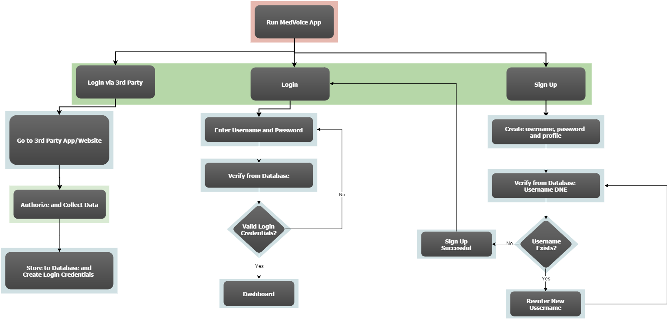
Login flowchart

Slide 7
Functions and security
Functions: Functions of the app and database would be reading/writing to the database and as well as admin access to some of that data.
Logical Database Requirements: Users will be able to push their contact information through to the database either by direct input or by Facebook login and information retrieval.
Security: The app will host preliminary security measures, which will include a signup/login mechanism with user account’s kept private. The security features of the database will keep this information encrypted.

Slide 8
Types of users
Careclient: Careclients are all ordinary users (patients) who will be seeking help from Caregivers. Careclients will be asked to enter their contact information (eg. name, phone number, email address, etc…) and their health information (eg. Birthday, height, weight, preexisting conditions, etc…) and have an option to keep some of this data private. Careclients will only be able to send data to the database, while the database will correlate said data and send said data back to the app. They will not be able to have direct access to said data.
Caregivers: Caregivers will be the doctors, nurses and practitioners. They will be asked to enter their contact and health information similar to the Careclients with additional information regarding their education, expertise, certifications, licenses, etc… They will have limited access to data through the app such as the patients’ health record. More possibilities of what type of data they will have access to will be to Careclients within a certain radius from their location or within a certain demographic having certain health issues.
Admins: Admins have the authority to add/delete users, grant permissions to Caregivers and to generate and view reports. Admins will also be able to view the complaints of patients and takes necessary actions.

Slide 9
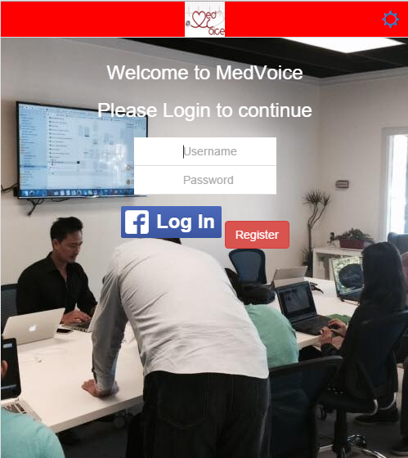
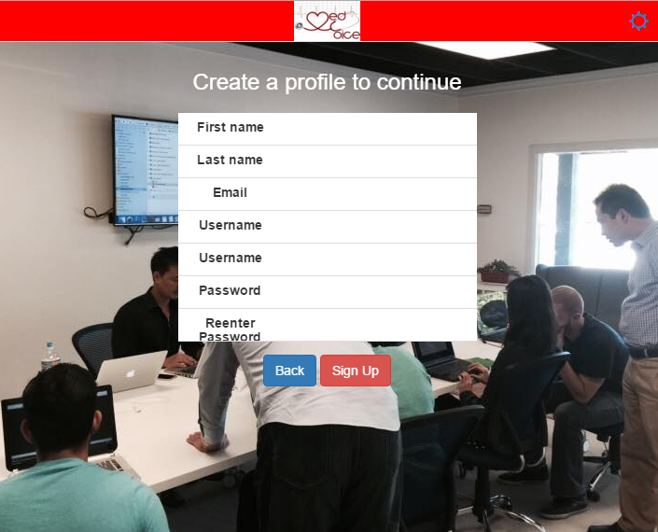
Start up screen and registration

